Slide 1
U.K MOTOR VEHICLE COLLISIONS
REPORT
January 2021- April 2023.

Slide 2
TABLE OF CONTENTS
01
02
03
04
RECOMMENDED ANALYSIS
PROBLEM AND SOLUTION
OBSERVATION
INSIGHTS

Slide 3

ABOUT ME
AJIMATI
EMMANUEL
Emmanuel Abayomi Ajimati: Data analyst by day, graphics designer by night. Passionate about unraveling data mysteries and turning insights into captivating visuals. Combining analytical skills with design flair to create informative and beautiful stories through dashboards and infographics. Dedicated to inspiring curiosity and guiding better business decisions through data-driven design.

Slide 4
RECOMMENDED ANALYSIS OF THIS PROJECT
Compare the % of total accidents by month. Do you notice any seasonal patterns?
Break down accident frequency by day of week and hour of day. Based on this data, when do accidents occur most frequently?
On which particular street were the most accidents reported? What does that represent as a % of all reported accidents?
What was the most common contributing factor for the accidents reported? What about for fatal accidents specifically?

Slide 5
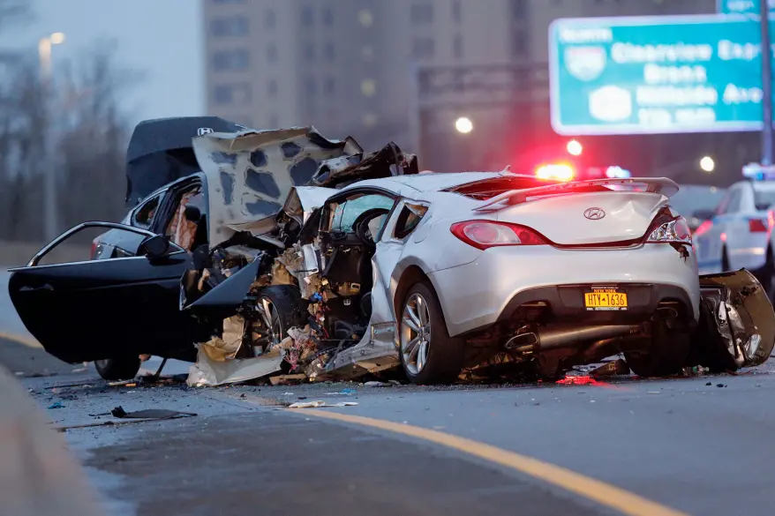
INTRODUCTION
Motor vehicle collisions reported by the New York City Police Department from January 2021 to April 2023. Each record represents an individual collision, including the date, time, and location of the accident (borough, zip code, street name, latitude/longitude), vehicles and victims involved, and contributing factors.

Slide 6
UK MOTOR VEHICLE COLLISIONS
January 2021- April 2023.

Slide 7
Dataset Description:
The dataset contains detailed information about traffic accidents, including the following columns:
Time: The time when the accident occurred.
Borough: The borough where the accident took place.
Street_Name: The name of the street where the accident occurred.
Cross_Street: The cross street nearest to the accident.
Latitude: The geographical latitude of the accident location.
Longitude: The geographical longitude of the accident location.
Contributing_Factor: The factor that contributed to the accident.
Vehicle Type: The type of vehicle involved in the accident.
Persons Injured: The number of persons injured in the accident.
Persons Killed: The number of persons killed in the accident.
Pedestrians Injured: The number of pedestrians injured in the accident.
Pedestrians Killed: The number of pedestrians killed in the accident.
Cyclists Injured: The number of cyclists injured in the accident.
Cyclists Killed: The number of cyclists killed in the accident.
Motorists Injured: The number of motorists injured in the accident.
Motorists Killed: The number of motorists killed in the accident

Slide 8
Project Overview: UK MOTOR VEHICLE COLLISIONS Analysis
Objective:
The primary goal of this project is to analyze traffic accident data to identify patterns, high-risk areas, and contributing factors. This analysis aims to provide insights that can help improve road safety and reduce the number of accidents.

Slide 9
01
PROBLEM AND SOLUTION

Slide 10
Recommended Analysis 1
Compare the % of total accidents by month. Do you notice any seasonal patterns?

Slide 11
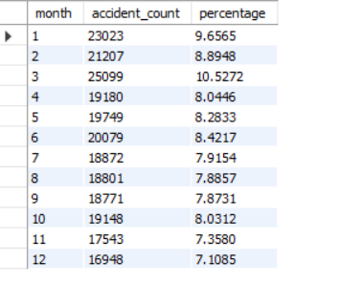
SOLUTION
SELECT MONTH(date) AS month, COUNT(*) AS accident_count, (COUNT(*) / (SELECT COUNT(*) FROM NYC_Collisions) * 100) AS percentage FROM NYC_Collisions
GROUP BY
MONTH(date);

Slide 12
Observation
Highest Number of Accidents: March has the highest number of accidents at 25,099, accounting for 10.5272% of all accidents.
Lowest Number of Accidents: December has the lowest number of accidents at 16,948, making up 7.1085% of the total.
Winter Months: January has a relatively high accident count at 23,023 (9.6565%), while February is lower at 21,207 (8.8948%) and December is the lowest.
Spring Peak: There is a peak in accidents in March (10.5272%), which might suggest that this month has unique factors leading to more accidents.
Summer and Fall: The accident percentages are relatively lower in July, August, and September, with the percentages below 8%. This could suggest fewer accidents during these months compared to other times of the year.

Slide 13
Possible Seasonal Patterns
Winter (Dec - Feb): Higher in January but overall lower in December.
Spring (Mar - May): Significant peak in March, followed by slightly lower numbers in April and May.
Summer (Jun - Aug): Generally lower accident counts, possibly due to better weather and road conditions.
Fall (Sep - Nov): Steady with a slight decrease in November.

Slide 14
Recommended Analysis 2
Break down accident frequency by day of week and hour of day. Based on this data, when do accidents occur most frequently?

Slide 15
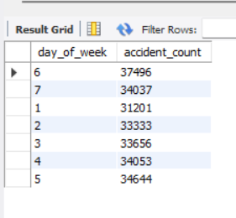
SOLUTION
SELECT DAYOFWEEK(date) AS day_of_week, COUNT(*) AS accident_count FROM NYC_Collisions
GROUP BY
DAYOFWEEK(date);

Slide 16
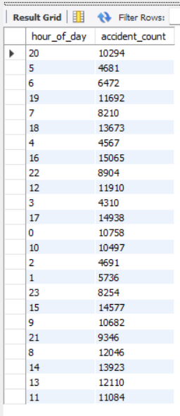
SOLUTION
SELECT HOUR(time) AS hour_of_day, COUNT(*) AS accident_count FROM NYC_Collisions
GROUP BY HOUR(time);

Slide 17
Observation
Peak Hours for Accidents:
Late Afternoon to Early Evening: The highest number of accidents occurs between 14:00 (2 PM) and 17:00 (5 PM), with the peak at 16:00 (3 PM) with 15,065 accidents.
Evening Hours: There are also significant numbers of accidents between 18:00 (6 PM) and 20:00 (8 PM), with 18:00 having 13,673 accidents.
Lowest Hours for Accidents:
Early Morning: The lowest accident counts are observed between 2:00 (2 AM) and 5:00 (5 AM), with the lowest at 3:00 (3 AM) with 4,310 accidents.
Morning to Midday:
There is a noticeable increase in accidents starting from 6:00 (6 AM), with counts gradually rising and peaking in the afternoon.
Early Morning: The early morning hours have the fewest accidents, likely due to lower traffic volumes during these times.
Steady Increase: Starting from 6 AM, accidents increase and remain relatively high through the morning and afternoon until peaking in the late afternoon.
Rush Hours: The data suggests that accidents are most frequent during the typical rush hours, particularly in the late afternoon and early evening. This could be due to increased traffic as people commute home from work.

Slide 18
Recommended Analysis 3
Determine the street with the most accidents and what that represents as a % of all reported accidents.

Slide 19
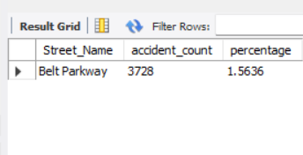
SOLUTION
SELECT Street_Name, COUNT(*) AS accident_count, (COUNT(*) / (SELECT COUNT(*) FROM NYC_Collisions) * 100) AS percentage FROM NYC_Collisions
GROUP BY Street_Name
ORDER BY accident_count DESC LIMIT 1;

Slide 20
Observation
Street with Most Accidents:
Belt Parkway: This street has the highest number of reported accidents at 3,728.
Percentage of Total Accidents:
The accidents on Belt Parkway represent 1.5636% of all reported accidents in the dataset.
High-Risk Area: Belt Parkway is identified as a high-risk area for accidents, contributing to a notable percentage of the total accidents.
Safety Measures: Given its high accident count, this street may require additional traffic safety measures, such as better signage, improved road conditions, or increased traffic enforcement.

Slide 21
Recommended Analysis 4
Identify the most common contributing factor for all accidents and for fatal accidents specifically.

Slide 22
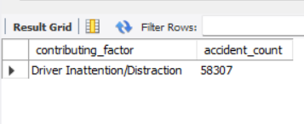
SOLUTION
SELECT contributing_factor, COUNT(*) AS accident_count FROM NYC_Collisions
GROUP BY contributing_factor
ORDER BY accident_count DESC LIMIT 1;
For all accidents

Slide 23
Observation
Most Common Contributing Factor:
Driver Inattention/Distraction: This is identified as the leading cause of accidents, with 58,307 incidents attributed to this factor.
Conclusion:
Significant Cause: Driver inattention or distraction is a major contributing factor, leading to a large number of accidents.
Safety Measures: To address this issue, measures such as public awareness campaigns, stricter enforcement of distracted driving laws, and the use of technology to minimize distractions could be considered

Slide 24
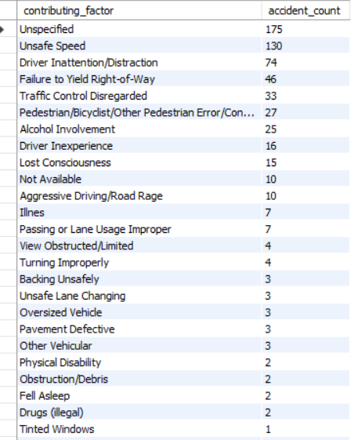
SOLUTION
SELECT contributing_factor, COUNT(*) AS accident_count FROM NYC_Collisions
WHERE `Persons Killed` > 0 OR `Pedestrians Killed` > 0 OR `Cyclists Killed` > 0 OR `Motorists Killed` > 0
GROUP BY contributing_factor
ORDER BY accident_count DESC;
For Fatal Accident

Slide 25
Observation
Top Contributing Factors:
Unspecified: 175 fatal accidents have an unspecified contributing factor, indicating a lack of detailed data for these cases.
Unsafe Speed: This is a major contributing factor, with 130 fatal accidents attributed to it.
Driver Inattention/Distraction: A significant contributing factor with 74 fatal accidents.
Failure to Yield Right-of-Way: 46 fatal accidents are due to this factor.
Traffic Control Disregarded: 33 fatal accidents are caused by disregarding traffic controls.
Other Significant Factors:
Pedestrian/Bicyclist/Other Pedestrian Error/Confusion: Contributing to 27 fatal accidents.
Alcohol Involvement: Responsible for 25 fatal accidents.
Driver Inexperience: 16 fatal accidents.
Lost Consciousness: 15 fatal accidents.
Less Frequent Factors:
Factors like "Aggressive Driving/Road Rage", "Illness", "Passing or Lane Usage Improper", and others have relatively lower counts but still contribute to fatal accidents.
Conclusion:
Data Gaps: A significant number of fatal accidents (175) have an unspecified contributing factor, indicating a need for better data collection and reporting.
Speed and Distraction: Unsafe speed and driver inattention/distraction are leading causes of fatal accidents, highlighting areas for targeted intervention.
Alcohol and Inexperience: Alcohol involvement and driver inexperience are also notable contributors, suggesting areas for public awareness and training programs.
Recommendations:
Improving Data Quality: Addressing the unspecified category by ensuring thorough data collection can provide more insights.
Speed Management: Implementing measures to control unsafe speeds could reduce fatal accidents.
Awareness Campaigns: Raising awareness about the dangers of driver inattention/distraction and alcohol consumption while driving can help mitigate these factors.
For Fatal Accident

Slide 26
INSIGHTS FOR UK MOTOR VEHICLE COLLISIONS
Seasonal Patterns
Monthly Analysis: Examined the percentage of total accidents by month to identify any seasonal patterns.
Findings: March has the highest percentage of accidents (10.5272%), while December has the lowest (7.1085%). There is a noticeable increase in accidents during the winter and spring months.
Accident Frequency by Time
Hourly Analysis: Analyzed the number of accidents by hour of the day.
Findings: Accidents are most frequent during late afternoon and early evening hours (14:00 to 18:00), with a peak at 16:00. The lowest number of accidents occurs in the early morning hours (2:00 to 5:00).

Slide 27
INSIGHTS FOR UK MOTOR VEHICLE COLLISIONS
High-Risk Areas
Street Analysis: Identified the street with the highest number of accidents.
Findings: Belt Parkway has the most accidents reported (3,728), representing 1.5636% of all reported accidents.
Contributing Factors
General Analysis: Determined the most common contributing factors for all reported accidents.
Findings: Driver Inattention/Distraction is the most common contributing factor, causing 58,307 accidents.

Slide 28
INSIGHTS FOR UK MOTOR VEHICLE COLLISIONS
Fatal Accidents
Specific Analysis: Analyzed the contributing factors specifically for fatal accidents.
Findings: The leading contributing factors for fatal accidents are:
Unspecified (175 accidents)
Unsafe Speed (130 accidents)
Driver Inattention/Distraction (74 accidents)
Failure to Yield Right-of-Way (46 accidents)
Traffic Control Disregarded (33 accidents)
Alcohol involvement, driver inexperience, and pedestrian/bicyclist errors are also significant contributors.

Slide 29
Recommendations
Data Quality Improvement: Enhance data collection processes to reduce the number of unspecified contributing factors.
Speed Management: Implement measures to control unsafe speeds, such as speed cameras and stricter enforcement of speed limits.
Awareness Campaigns: Launch public awareness campaigns focusing on the dangers of distracted driving and the importance of following traffic controls.
Safety Enhancements: Improve safety measures on high-risk roads like Belt Parkway and consider infrastructure improvements to reduce accidents.

Slide 30
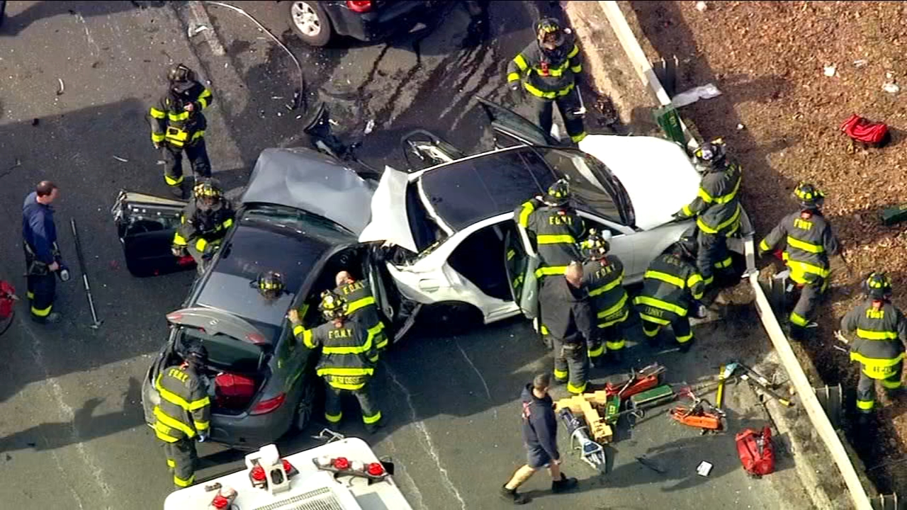
A PICTURE IS WORTH THOUSAND WORDS

Slide 31
—SOMEONE FAMOUS
“From Collisions to transformations.” #AccidentAwakenings

Slide 32
THANK YOU!
Do you have any questions?
ajimatiabayomi@gmail.com
+2348137683758
LinkedIn
Twitter
+2348137683758

